Slide 1
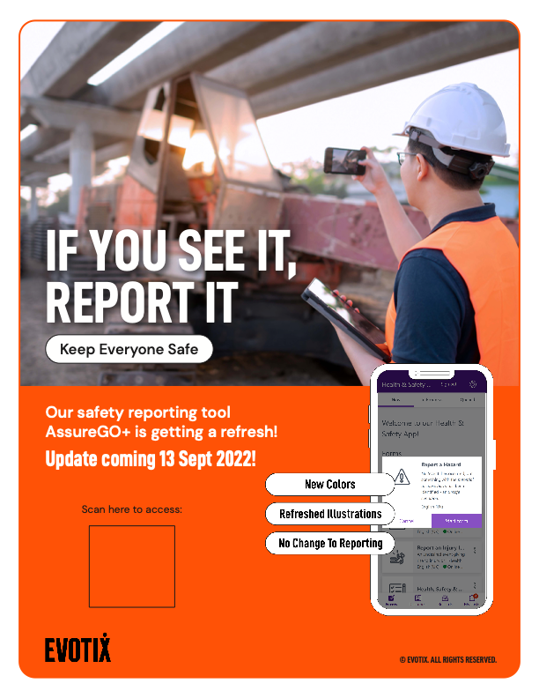

Slide 2
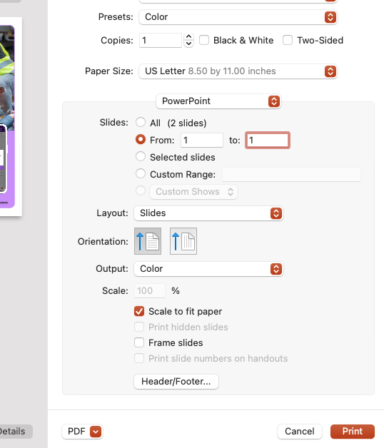
Instructions
Please customise the poster as you see fit
Add your company logo in the top left corner
Add the QR code to your AssureGO+
You can find the QR code in the edit screen for your AssureGO+ portal
Printing instructions
Print page 1 only
Select ‘Scale to Fit’
Make sure to print in color and uncheck ‘Black & White’

